Slide 1
ONLINE EXAMINATION SYSTEM

Slide 2

INTRODUCTION
Online Examination System has become a fast growing examination method because of its speed and accuracy.
Need less manpower to execute online examination.
Easy to check the performance of the student
Helps the environment by saving paper.

Slide 3

TRADITIONAL SYSTEM
Existing system is manual
Keeping of the details of the student who have registered already
Difficult for some students from far distance to reach the exam centre
Prepare registration\application form, question paper for the students
Lot of time and wastage of money
Possibility of errors

Slide 4

PROPOSED SYSTEM
Overcome the drawbacks of existing manual system
Result will be precise and declared in short time
No chances of leakage of question papers
Logs of appeared candidates and their marks are stored and backup for future use.

Slide 5
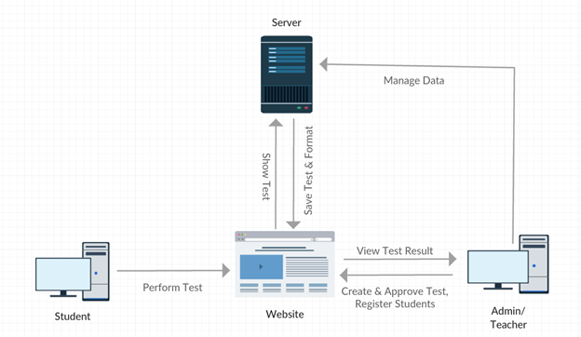
NETWORK DIAGRAM

Slide 6
DATABASE TABLES USED
Exam
Exam State
Result Information
College Information
User Information
Mails

Slide 7



FRONTEND TECHNOLOGIES

Slide 8


BACKEND SOFTWARE
TECHNOLOGY USED

Slide 9


ADVANTAGES
Provides complete online web-based solution, including student registration, giving tests, storing of results.
Complete web-based administration, administrator can manage
examination and question bank from web interface.
No geographical boundary
Student can give examination from anywhere of the world by 24X7
100% accuracy in result calculation
Randomization of question set

Slide 10
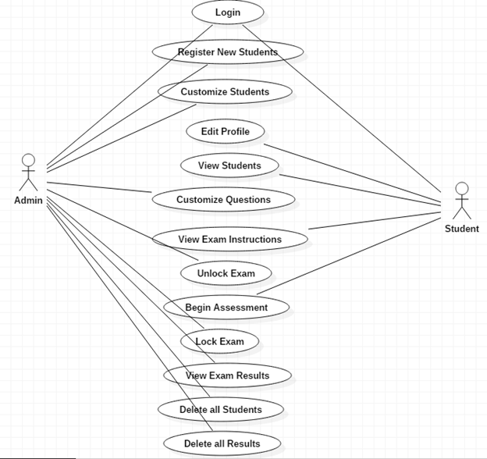
USE CASE DIAGRAM

Slide 11
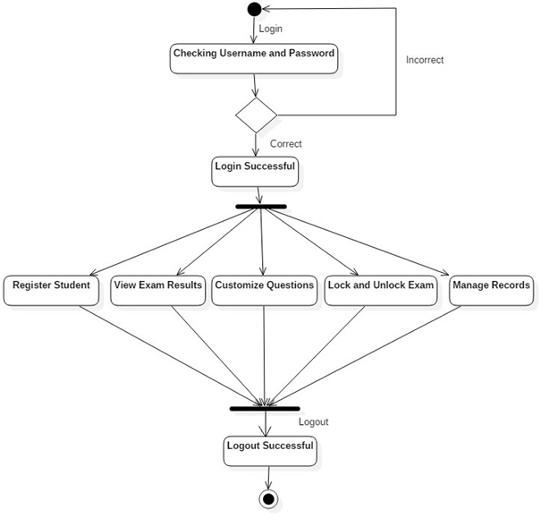
ACTIVITY DIAGRAM
FOR ADMIN

Slide 12
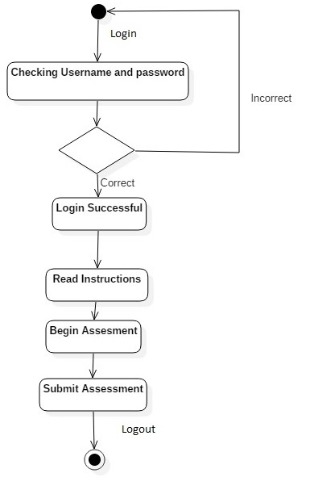
ACTIVITY DIAGRAM
FOR STUDENT

Slide 13
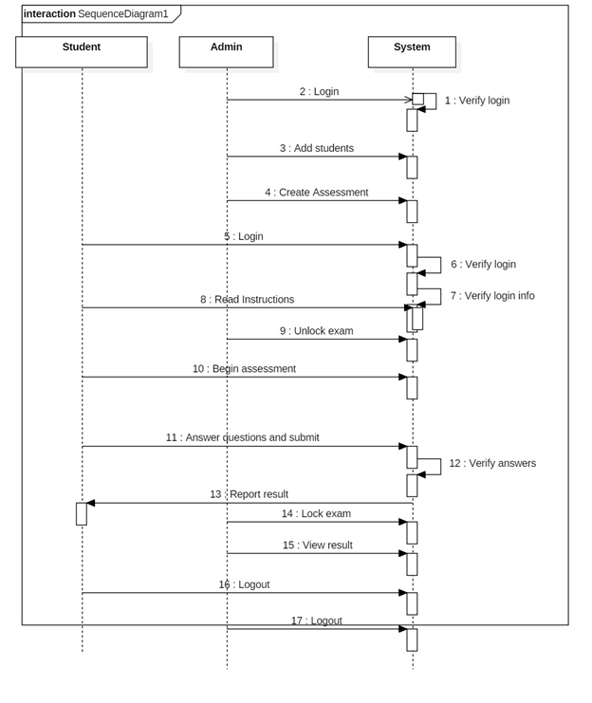
SEQUENCE DIAGRAM

Slide 14
THANKYOU
Roll No | Name | Gr No
29 | Punamtanvi Kshatriya | 11810462
35 | Shivani Mukunde | 11810612
44 | Preeti | 11811321
46 | Shreerang Rathodkar | 11810110

